Slide 1
Name | James
Git Hash | 0df3249a3ba0853b8c291e061eccfbd9fc56a0b3
Sprint number | Start date | end date | Work hard rating
3 | 2/5/22 | 27/5/22 | 3/5

Slide 2
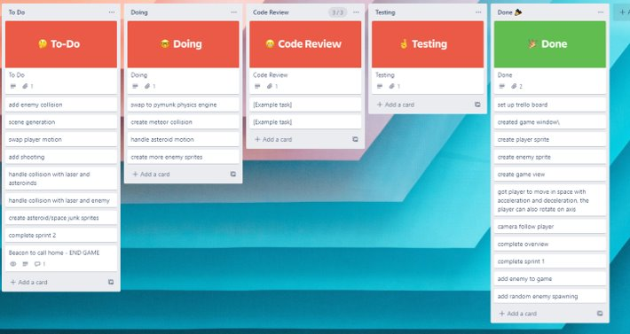
KANBAN board at the start of the sprint

Slide 3
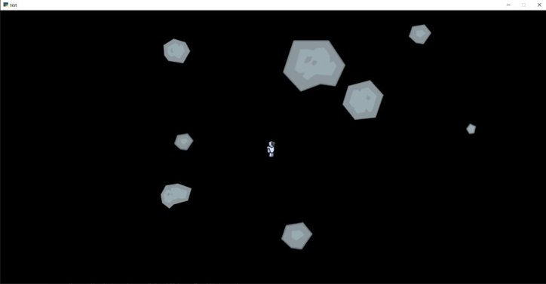
Screenshot of the game at the start of the sprint

Slide 4
Sprint Reflection and summary
This sprint was double the length of other sprints being 4 weeks long this was due to our work over the first 2 weeks not being done and we needed more time extending the duration of the sprint. I think i did a pretty alright workload for this sprint compared to the last.
I was able to begin implementing the pymunk physics engine into the game making thew player and other asteroids contact each other and bounce of each other however i ran into problems with tuning their weights and the overall forces used by the physics engine and was unable to make the meteors move quickly but the player was able to move throughout the map. I ran into a bug with the spawn rate of meteors, they didn't have a cap on the spawned amount and eventually caused the game to slow down and crash. This bug couldn't be fixed in this sprint but will in the future. Overall, the early implementation of pymunk was success and i am now able to understand how pymunk should be used and how is operates because i learnt more about it before trying it out. Overall, i think i did a good amount of working beginning to implement the physics engine into the game and this sprint showed progress in the games development and shows promise that the end product will work and be wanted.

Slide 5
Briefly describe other team members contributions
Cameron designed and added a sprite to replace the test meteors and they worked well in the game and look good, however they were blurry due to the scaling done them by the game to change their size, this could be fixed my him by making the original sprite larger and then down scaling it through the game to different sizes.
He also created a new file where he began coding the steering and avoiding mechanics for the enemy target the player, these mechanics worked well and showed high potential for the enemy in the game.
He was also able to finish the code for enemy spawning and they now spawn out of the view of the player so they dont notice them being generated.
Overall he did a large amount of work in this sprint and made the game take huge progress in the right direction

Slide 6
Major Changes and Achievements Described
The Pymunk physics engine began to be implemented into the game for the meteors and the player where when their hit boxes touch the collide and bounce off each other in a realistic way to help simulate the game. Each body in the physics engine had mass and origin velocity which enable further calculations to be done by he engine to simulate how it reacts in its environment, due to the use of Pymunk the file size of the game was reduced because i didnt have to code a new physics engine for the game making it easier to make. Still alot of work needed to finsih its implementation.
New meteor sprite were added to the game to give a more realistic design to them to help make progress in the games look
Enemy control mechanics were being tested and built to enable the enemy to navigate towards the player and intercept them which would enable the game to grow in progress

Slide 7
Brief Description of your testing
To test whether the physics engine was working, we opened up the game and flew the player towards meteors to see if the collided, we found that they collided however due to the overpopulation of meteors the map began to gridlock making the game not usable while slowing it down because each asteroid was in the physics meaning lots calculation being done. The physics engine passed its round tests showing that the player is indeed able to collide with meteors.
To test if the steering worked and looked realistic cameron created a file within the repository that independently housed the code with its own window, we then opened it up and tested the mechanics. We found that the followed a trajectory towards the objects we wanted them to follow, we found it worked and we showed other people like Mr Ward and Anouk and they said it look realistic. Overall after some tuning the mechanics passed their testing.
We tested whether the new meteor sprite looked good in the game and it looked good, we showed Anouk and they liked the look but said it was a bit blurry and would need to fix that.

Slide 8
Link to testing results/tables

Slide 9
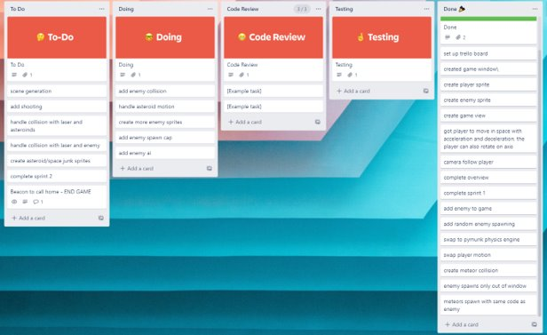
KANBAN board at the end of the sprint

Slide 10
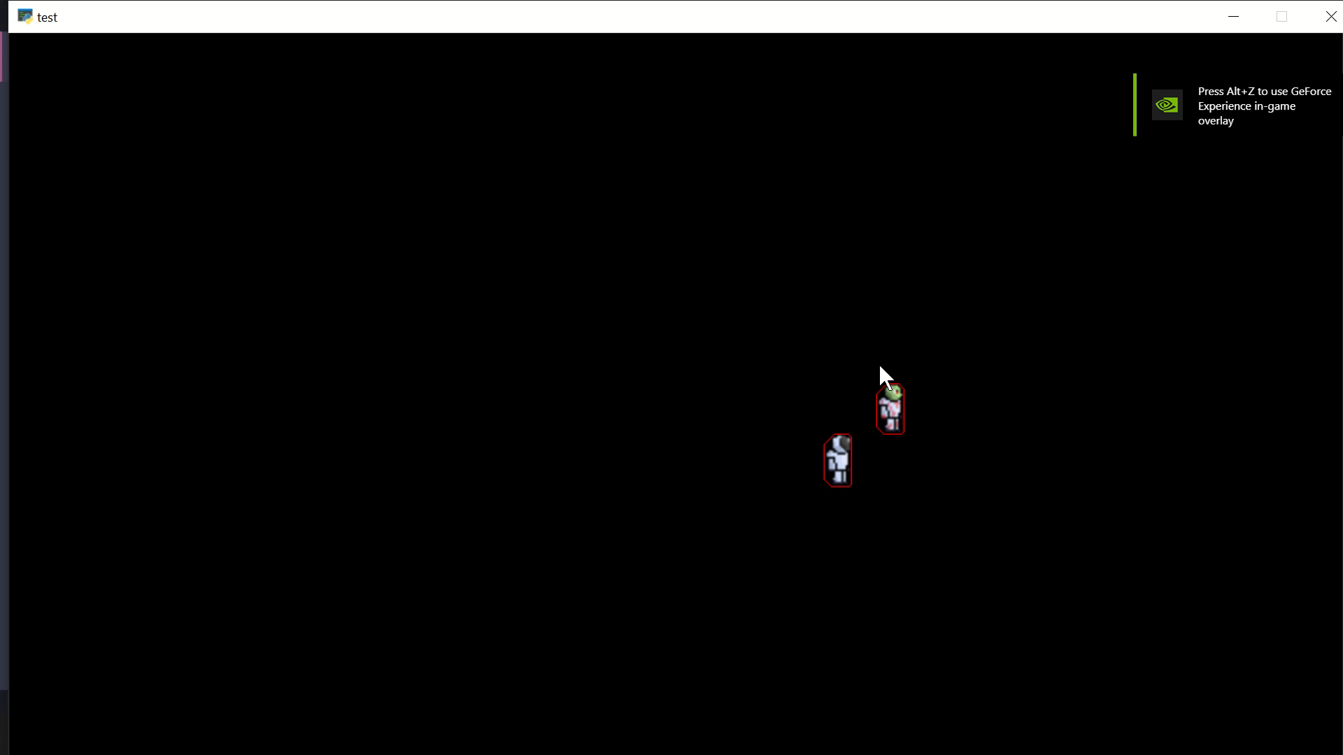
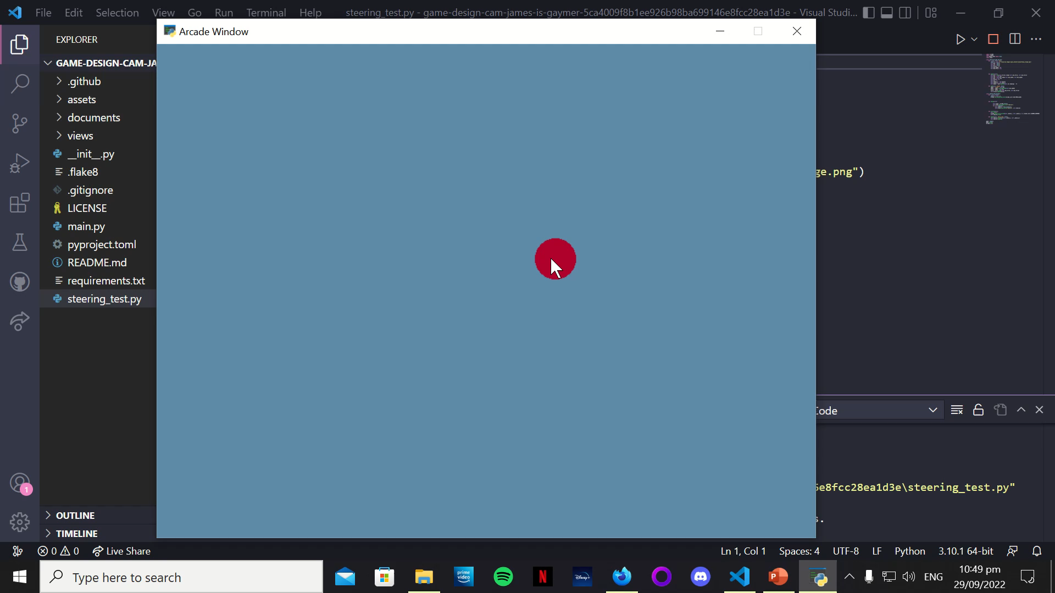
Video of the game at the end of the sprint

Slide 11
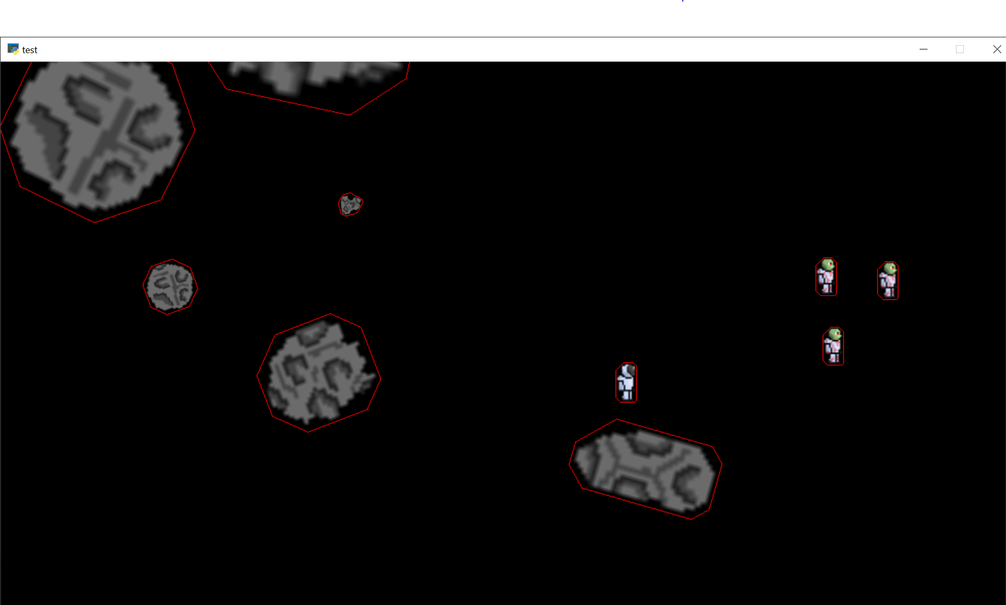
Screenshot of the game at the end of the sprint

Slide 12
Notes for next time, future improvements
For future improvements i want to have the physics engine fully implemented and running with the game so that it works well without any bugs, i would've liked to have more done this sprint but i expected too much of myself so next time i want to plan it out more reasonably. I also believe that the game progress should be sped up bit though because for 3 sprints they have been quite slow especially on my part and finishing the physics engine.

